Slide 1
Overview of C# Programming Language
C# is a modern, general-purpose, object-oriented programming language developed by Microsoft and approved by European Computer Manufacturers Association (ECMA) and International Standards Organization (ISO).
Programming Features of C#
Boolean Conditions
Automatic Garbage Collection
Standard Library
Assembly Versioning
Properties and Events
Delegates and Events Management
Easy-to-use Generics
Indexers
Conditional Compilation
Simple Multithreading
LINQ and Lambda Expressions
Integration with Windows

Slide 2




Environment
The .Net Framework
The .Net framework is a revolutionary platform that helps you to write the following types of application
Web
Application
Desktop
Application
Web
Services
Common Language Runtime (CLR)
The .Net Framework Class Library
Common Language Specification
Common Type System
Metadata and Assemblies
Windows Forms
ASP.Net and ASP.Net AJAX
ADO.Net
Windows Workflow Foundation (WF)
Windows Presentation Foundation
Windows Communication Foundation (WCF)
LINQ
The .Net framework consists of an enormous library of codes used by the client languages such as C#. Following are some of the components of the .Net framework

Slide 3


Integrated Development Environment (IDE) for C#
Visual Studio
Code
Microsoft Visual Studio is an integrated development environment from Microsoft. It is used to develop computer programs, as well as websites, web apps, web services and mobile apps
Visual Studio Code is a source-code editor made by Microsoft for Windows, Linux and macOS. Features include support for debugging, syntax highlighting, intelligent code completion, snippets, code

Slide 4
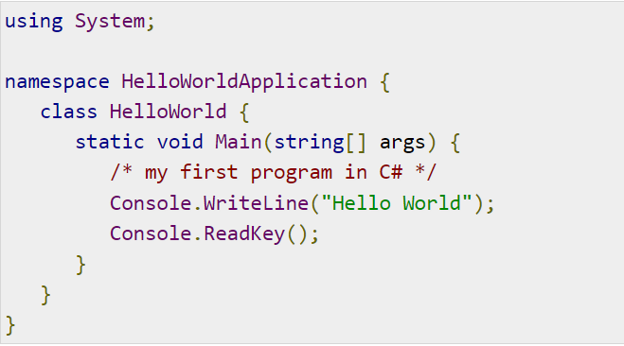
Creating Hello World Program
Namespace declaration
A class
Class methods
Class attributes
A Main method
Statements and Expressions
Comments
C# is case sensitive.
All statements and expression must end with a semicolon (;).
The program execution starts at the Main method.
Unlike Java, program file name could be different from the class name.

Slide 5
Member Variables
Variables are attributes or data members of a class, used for storing data. In the preceding program, the Rectangle class has two member variables named length and width.
Member Functions
Functions are set of statements that perform a specific task. The member functions of a class are declared within the class. Our sample class Rectangle contains three member functions: AcceptDetails, GetArea and Display.
Instantiating a Class
In the preceding program, the class ExecuteRectangle contains the Main() method and instantiates the Rectangle class.
Identifiers -a class, variable, function, or any other user-defined item.
A name must begin with a letter that could be followed by a sequence of letters, digits (0 - 9) or underscore.
The first character in an identifier cannot be a digit.
It must not contain any embedded space or symbol such as? - + ! @ # % ^ & * ( ) [ ] { } . ; : " ' / and \.
However, an underscore ( _ ) can be used.
It should not be a C# keyword.

Slide 6
C# Keywords
Reserved Keywords
abstract | as | base | bool | break | byte | case
catch | char | checked | class | const | continue | decimal
default | delegate | do | double | else | enum | event
explicit | extern | false | finally | fixed | float | for
foreach | goto | if | implicit | in | in (generic modifier) | int
interface | internal | is | lock | long | namespace | new
null | object | operator | out | out (generic modifier) | override | params
private | protected | public | readonly | ref | return | sbyte
sealed | short | sizeof | stackalloc | static | string | struct
switch | this | throw | true | try | typeof | uint
ulong | unchecked | unsafe | ushort | using | virtual | void
volatile | while

